Slide 1
Security Tools – Typical Enterprise (Part 2)
NSS Labs Security Value Map (SVM)
Some additional Gartner Magic Quadrant reports

Slide 2
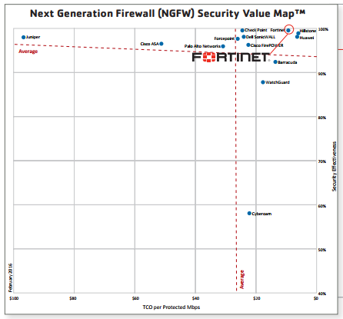
Security Tools – Typical Enterprise (Part 2)
NGFW
NSS Labs
2016
Hillstone
Huawei
Fortinet
https://www.fortinet.com/content/dam/fortinet/assets/analyst-reports/Brochure-NSS-Lab-Independent-Validation.pdf

Slide 3
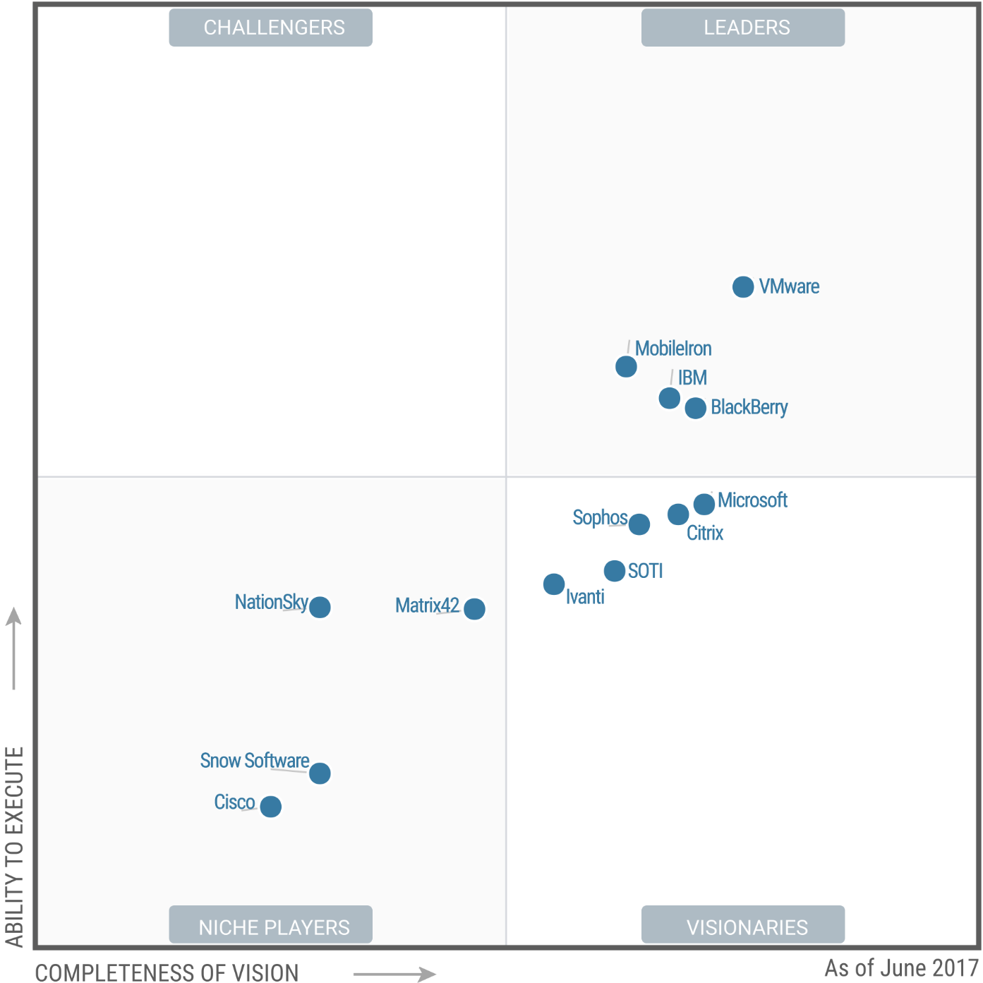
Security Tools – Typical Enterprise (Part 1)
Enterprise
Mobility
Management
(EMM)
June 2017
VMWARE
MobileIron
IBM
Blackberry
https://www.gartner.com/doc/reprints?id=1-42A6Q84&ct=170607&st=sb

Slide 4
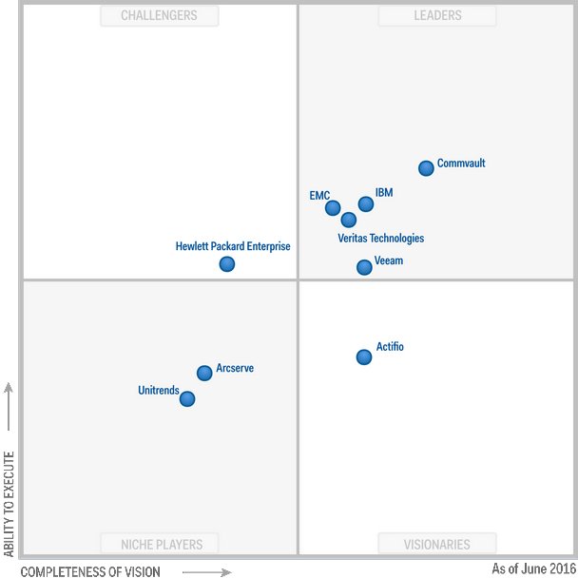
Security Tools – Typical Enterprise (Part 1)
DC Backup
& Recovery
June 2016
Commvault
IBM
EMC
Veritas
https://www.gartner.com/doc/reprints?id=1-38JSYOW&ct=160602&st=sb

Slide 5
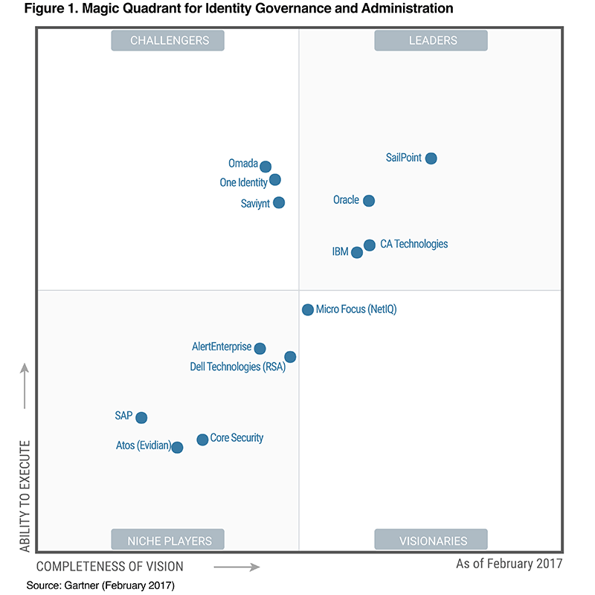
Security Tools – Typical Enterprise (Part 1)
Identity,
Governance
Feb 2017
Sailpoint
Oracle
CA
IBM
https://www.sailpoint.com/identity-governance-leader-gartner-magic-quadrant/

Slide 6
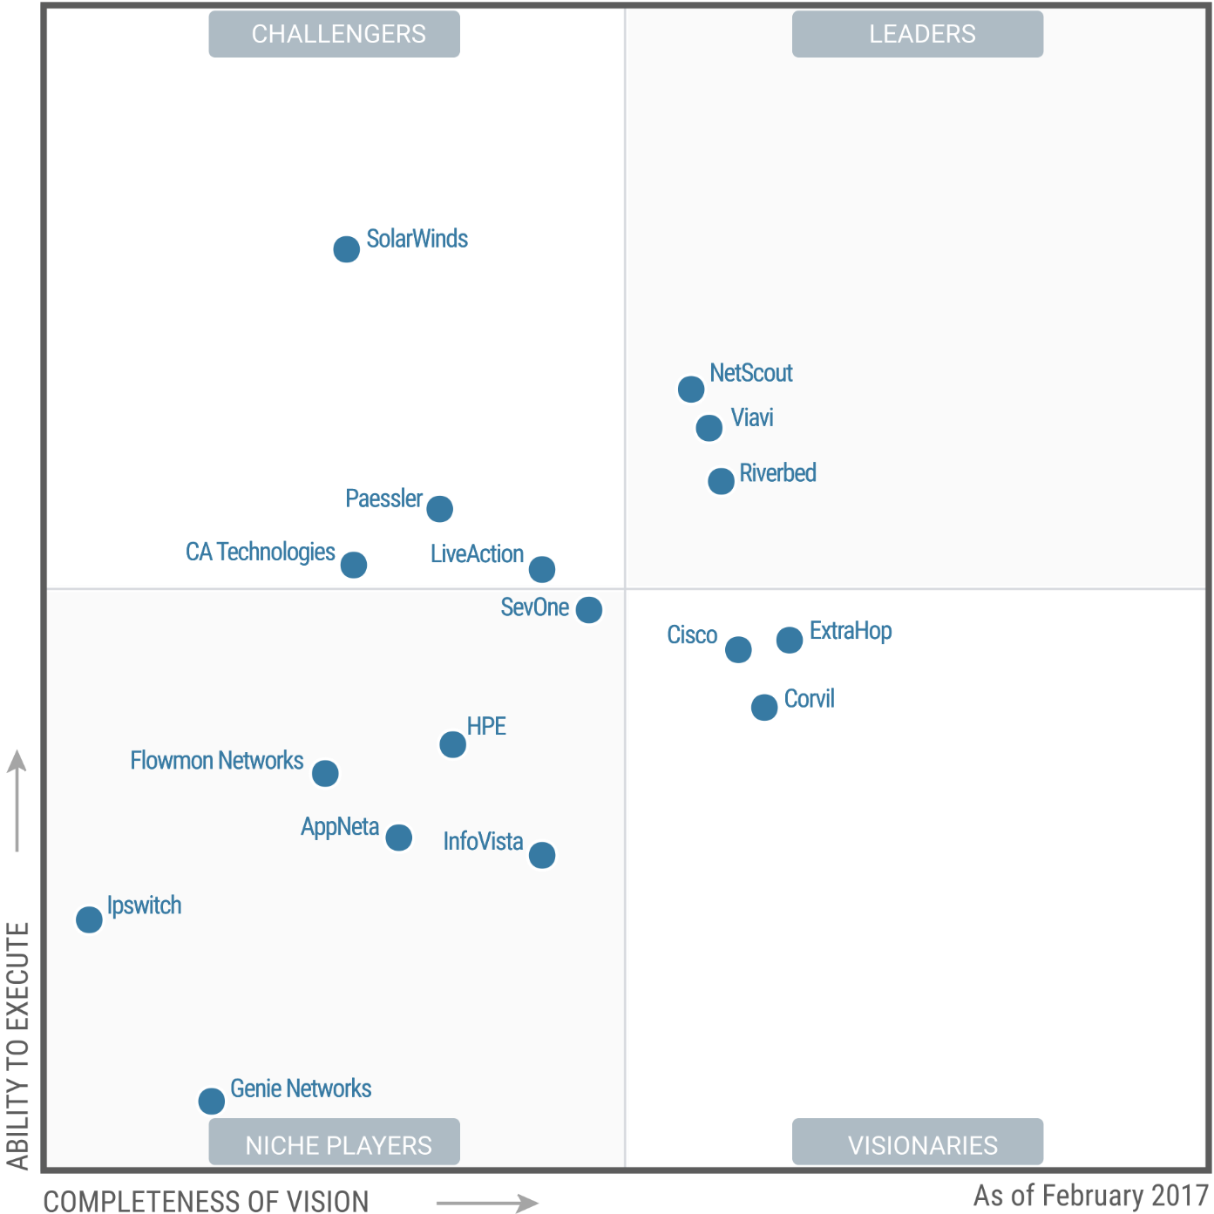
Security Tools – Typical Enterprise (Part 1)
Network Perf
Monitoring
& Diagnostics
Feb 2017
NetScout
Viavi
Riverbed
https://www.gartner.com/doc/reprints?id=1-3TYUQFH&ct=170221&st=sb

Slide 7
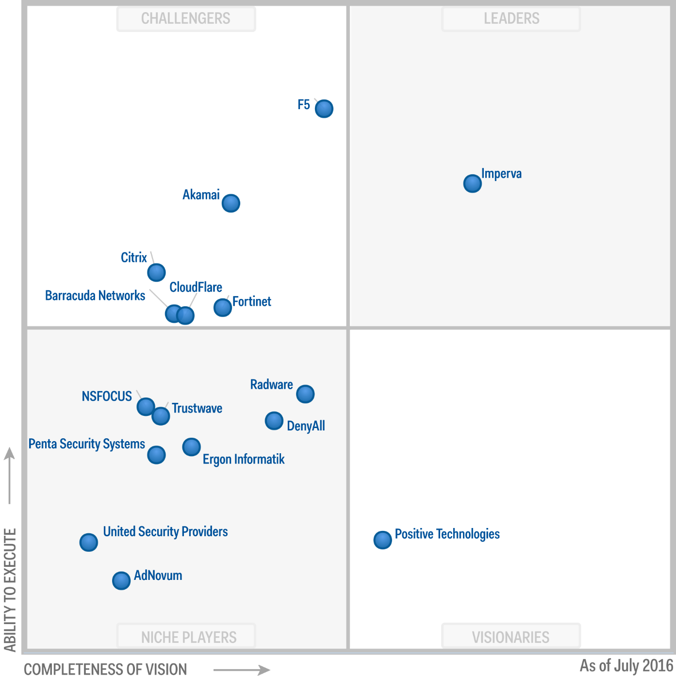
Security Tools – Typical Enterprise (Part 1)
Web App FW
July 2016
Imperva
https://www.gartner.com/doc/reprints?id=1-3TYUQFH&ct=170221&st=sb

Slide 8
Security Tools – Typical Enterprise (Part 2)
Gartner
Forrestor
NSS labs
ICSA Labs
END

